Slide 1

RUNGTA COLLEGE OF DENTAL SCIENCES & RESEARCH
TITLE OF THE TOPIC-
MECHANICS OF TOOTH MOVEMENT
DEPARTMENT OF ORTHODONTICS AND DENTOFACIAL ORTHOPAEDICS

Slide 2
Specific learning Objectives
CORE AREAS | DOMAIN | CATEGORY
FORCE AS VECTORS | PSYCHOMOTOR | MUST KNOW
FORCE AND MOVEMENT | PSYCHOMOTOR | NICE TO KNOW
TYPES OF TOOTH MOVEMENT | COGNITIVE | MUST KNOW
TYPES OF FORCE | COGNITIVE | NICE TO KNOW

Slide 3
CONTENTS
PART 1
INTRODUCTION
FORCE AS VECTORS
FORCE AND MOVEMENTS
  CENTRE OF RESISTANCE
  CENTRE OF ROTATION
  MOMENT
PART II
TYPES OF TOOTH MOVEMENT
  TRANSLATION
  TIPPING
  COUPLE
TYPES OF FORCE
  INTERMITTENT
  INTERUPTED
  CONTINUOUS

Slide 4
INTRODUCTION
‘Mechanics is the study of the effect of forces on a body.’
Theories of mechanics has potential applications in 3 areas:
  Precise application of force
  Understanding of clinical and histological response to various magnitude of force
  Improving the design of orthodontic appliances.
Proper application of mechanics to orthodontic treatment helps in:
  Increasing the treatment efficiency
  Reduce the treatment time

Slide 5
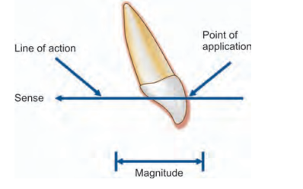
FORCE AS VECTORS
Force can be defined as ‘an act upon a body that changes or tends to change the state of rest or of motion of that body.
In clinical terms it is either push or pull
Force = mass * acceleration F= (ma)
Forces can be represented using vectors. They have specific magnitude and direction.

Slide 6
FORCE AS VECTORS
To understand how a body reacts to more than one force requires the creation of a vector diagram.
Sometimes a single force may be resolved into components to simplify or study its effect on a particular body.

Slide 7
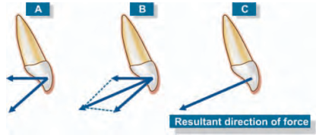
FORCE AS VECTORS
In the simplest scenario, with the point of application of say two forces being at a common point,
The resultant is indicated by the diagonal of the parallelogram drawn using the vectors of the two forces

Slide 8
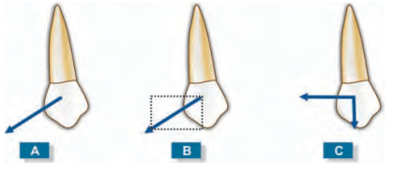
FORCE AS VECTORS
Single force can be resolved by splitting the force vectors into two components at right angles to each other, into a vertical and horizontal component

Slide 9
FORCE AND MOVEMENTS
CENTRE OF RESISTANCE
Every unrestrained body has a point at which it can (at least in theory) be perfectly balanced. This point is called the center of gravity.
When we talk about teeth, we are talking of a body which is restrained by adjacent structures like the periodontal ligament etc. for such restrained bodies the analogous point to the center of gravity is called the center of resistance.

Slide 10
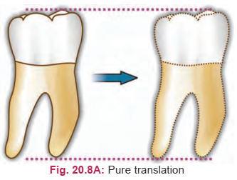
FORCE AND MOVEMENTS
CENTRE OF RESISTANCE
By definition, as the point in the object at which the resistance to movement is at the maximum.
If a force is applied to the center of resistance, the whole body moves equally in the direction of force applied (translation).

Slide 11
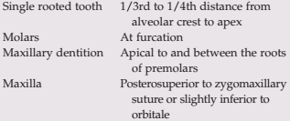
FORCE AND MOVEMENTS
CENTRE OF RESISTANCE

Slide 12
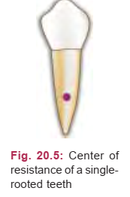
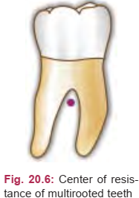
FORCE AND MOVEMENTS
CENTRE OF RESISTANCE

Slide 13
FORCE AND MOVEMENTS
CENTRE OF RESISTANCE
Center of resistance varies with:
• Root length.
• Alveolar bone height.
• The root morphology- single or multirooted teeth

Slide 14
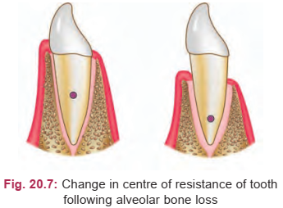
FORCE AND MOVEMENTS
CENTRE OF RESISTANCE
The center of resistance sometimes changes with root resorption or loss of alveolar support because of periodontal disease
For example, in the case of loss of alveolar support, this point moves apically

Slide 15
FORCE AND MOVEMENTS
CENTRE OF ROTATION
The center of rotation is any point around which rotations occur when the tooth is being moved.
When a body rotates, there is a point located either internal or external to the body around which the body turns.

Slide 16
FORCE AND MOVEMENTS
CENTRE OF ROTATION
This point is termed the center of rotation. The location of this point is dependent on the force system applied to the tooth
The center of rotation is located at variable points depending on how far the force is applied from the center of resistance.

Slide 17
FORCE AND MOVEMENTS
CENTRE OF ROTATION
The center of rotation can approach, but it can never reach the center of resistance.
If the force is applied at the center of resistance, the body translates and the center of rotation is at infinity

Slide 18
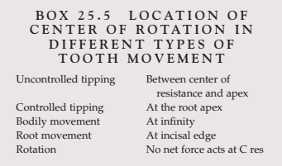
FORCE AND MOVEMENTS
CENTRE OF ROTATION

Slide 19
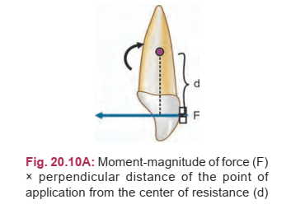
FORCE AND MOVEMENTS
MOMENT OF FORCE
When the line of action of an applied force does not pass through the center of resistance the force will produce some rotation.
The potential for rotation is measured as a moment.

Slide 20
FORCE AND MOVEMENTS
MOMENT OF FORCE
A moment may be determined by multiplying the magnitude of the force (F) by the perpendicular distance (d) from the center of resistance to the line of
action of this force: M = F * d.
where,
M is the moment,
F, the magnitude of force, and
d, the perpendicular distance of the point of
application from the center of resistance

Slide 21
FORCE AND MOVEMENTS
MOMENT OF FORCE
The moment is measured in units such as gram millimeters.
Hence, the moment of force can be altered by changing the magnitude of the force or by changing the perpendicular distance of the line of action of the force to the center of resistance.
Hence, if the magnitude of the moment needs to be decreased, the force can be applied closer to the center of resistance of the tooth

Slide 22
TYPES OF TOOTH MOVEMENTS
Tooth movement can be described in many ways. The basic types of tooth movement are:
  1. Tipping
  2. Translation
  3. Root movement
  4. Rotation

Slide 23
TYPES OF TOOTH MOVEMENTS
Tipping
Tipping is the simplest tooth movement and the one easily carried out.
In tipping, there is greater movement of the crown than that of the root.
There are two types of tipping:
Uncontrolled tipping and Controlled tipping

Slide 24
TYPES OF TOOTH MOVEMENTS
Uncontrolled Tipping
Uncontrolled tipping is produced when a single force is applied to the crown of a tooth.
The crown moves in one direction and the root moves in the opposite direction.
Uncontrolled tipping is useful when incisors have to be proclined

Slide 25
TYPES OF TOOTH MOVEMENTS
Features of Uncontrolled Tipping
Center of rotation: It is in between the center of resistance and apex of the root
Force required: 35–60 g
Moment to force ratio: 0:1 to 5:1

Slide 26
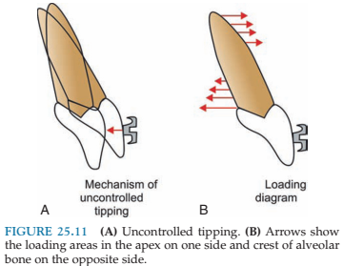
TYPES OF TOOTH MOVEMENTS
Features of Uncontrolled Tipping
Loading pattern: The periodontal ligament (PDL) is stressed near the apex on the same side as the applied force and at the crest of the alveolar bone on the opposite side

Slide 27
TYPES OF TOOTH MOVEMENTS
Controlled Tipping
This is a desirable tooth movement when compared to uncontrolled tipping.
The crown moves in one direction and there is minimal or no movement of the root in the opposite direction.
Controlled tipping is useful in retraction of excessively proclined incisors when roots are normally positioned

Slide 28
TYPES OF TOOTH MOVEMENTS
Features of Controlled Tipping
Center of rotation is at the root apex
Force required: 35–60 g
Moment to force ratio = 7:1

Slide 29
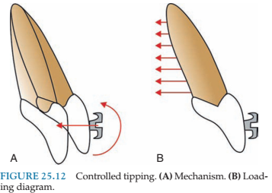
TYPES OF TOOTH MOVEMENTS
Features of Controlled Tipping
Loading pattern: There is minimum stress of the PDL at root apex. This prevents root movement.

